Slide 1
Multidimensional Fourier Transform
Jesper Rindom Jensen, jrj@es.aau.dk
Advanced Signal Processing, Electronic Systems, Aalborg University

Slide 2

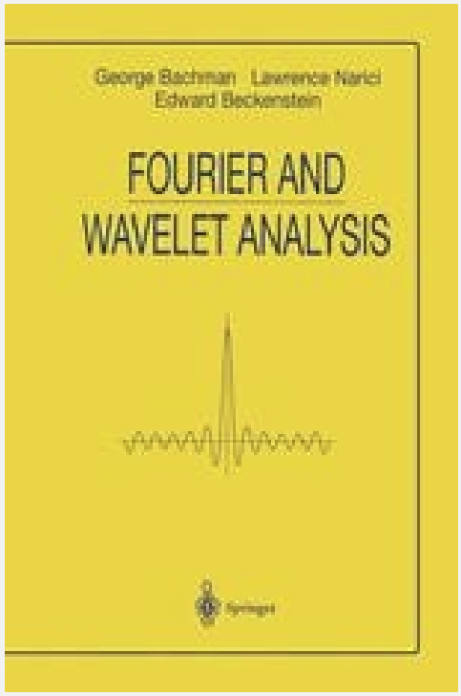
Agenda
Overview of the general idea behind Fourier series
Fourier transform and basic properties
Extension of the FT to multiple dimensions

Slide 3
Signals, systems, and measurements
We want to study a particular system, by measuring a signal f.
How is the signal measured in practice?
Possible solutions:
We have an instrument I, which can perfectly measure the signal in time, f(t).
Alternatively (and practially), we may have a number of samples of the signal, e.g., at equidistand sampling intervals, f[n] = f(nT), where T is the sampling period.

Slide 4
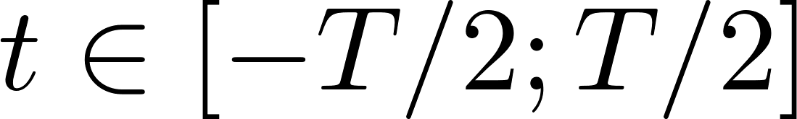
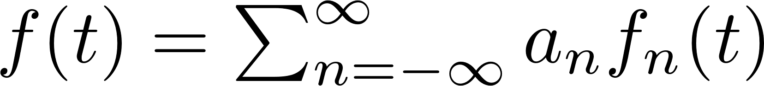
The Fourier Series
Recall that we want to measure a real signal.
Consider and orthogonal basis of functions, f_{n}.
Using this, we may express our signal as a linear combination of these functions in a bounded interval, :
Coefficient associated with the n’th basis function

Slide 5
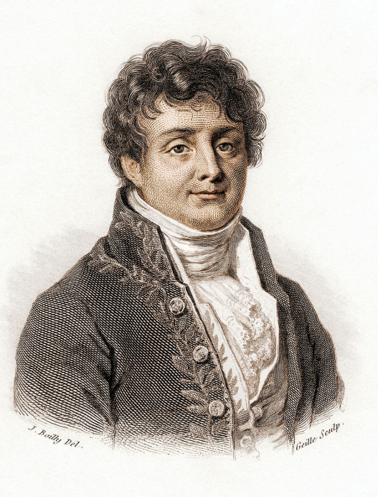
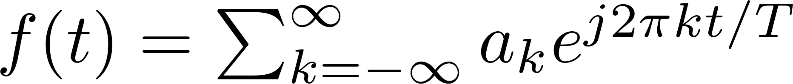
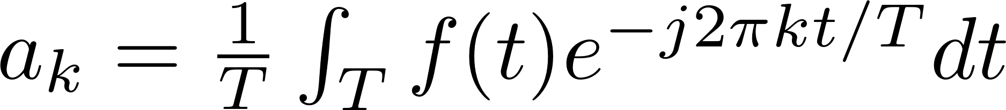
The Fourier Series
Already in the 18th century, Fourier claimed that any periodic function can be written as a series of trigonometric function.
Mathematically, this can be expressed as:
For analysis, we can use the inverse relationship:

Slide 6
Importance of Periodic Signals
Many physical phenomena exhibit periodic behaviour and can thus be modeled and analyzed using periodic basis functions:
Sound waves (musical instruments).
AC electrical signals
Planetary motion (orbits)
Pendulum motion (simple harmonic oscillator)
Rotating machinery
Heartbeats (ECG)
Seasonal climate patterns.
Biological rhythms (circadian rhythms)
Moreover, sinusoidal functions are eigenfunctions of LSI systems.

Slide 7

Beyond Periodic Functions
While many natural phenomena are periodic, not all are.
Moreover, even some of the aforementioned phenomena are not perfectly periodic.
We can extend the Fourier series, by
considering an unbounded interval, .
considering the frequency as being continuous.
This functional operator is referred to as the Fourier Transform.

Slide 8
Fourier Transform
Fourier Transform (analysis)
Inverse Fourier Transform (synthesis)

Slide 9
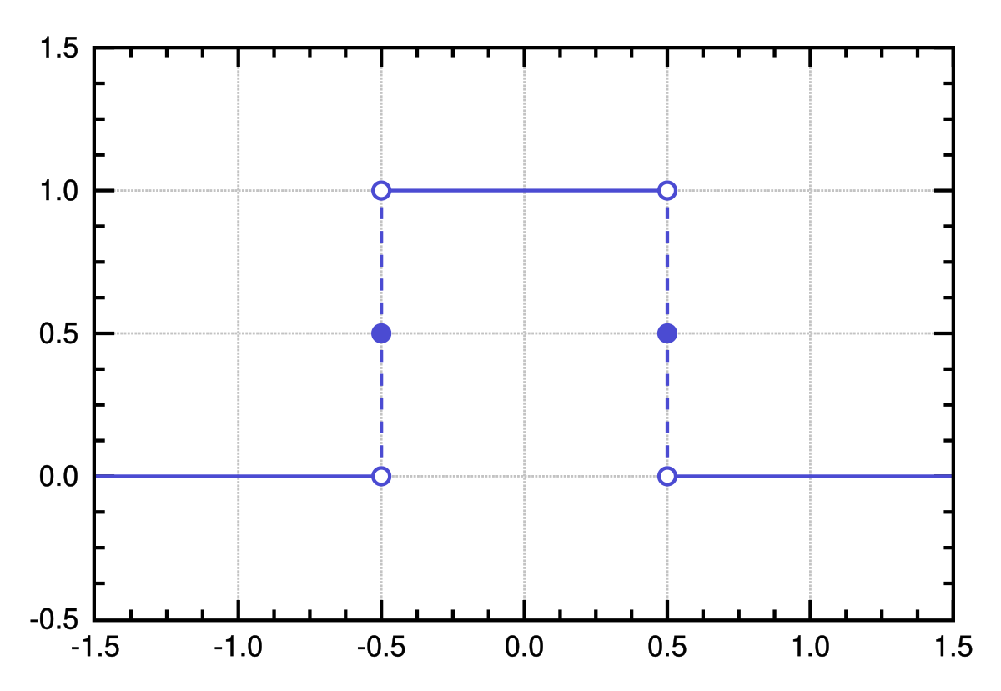
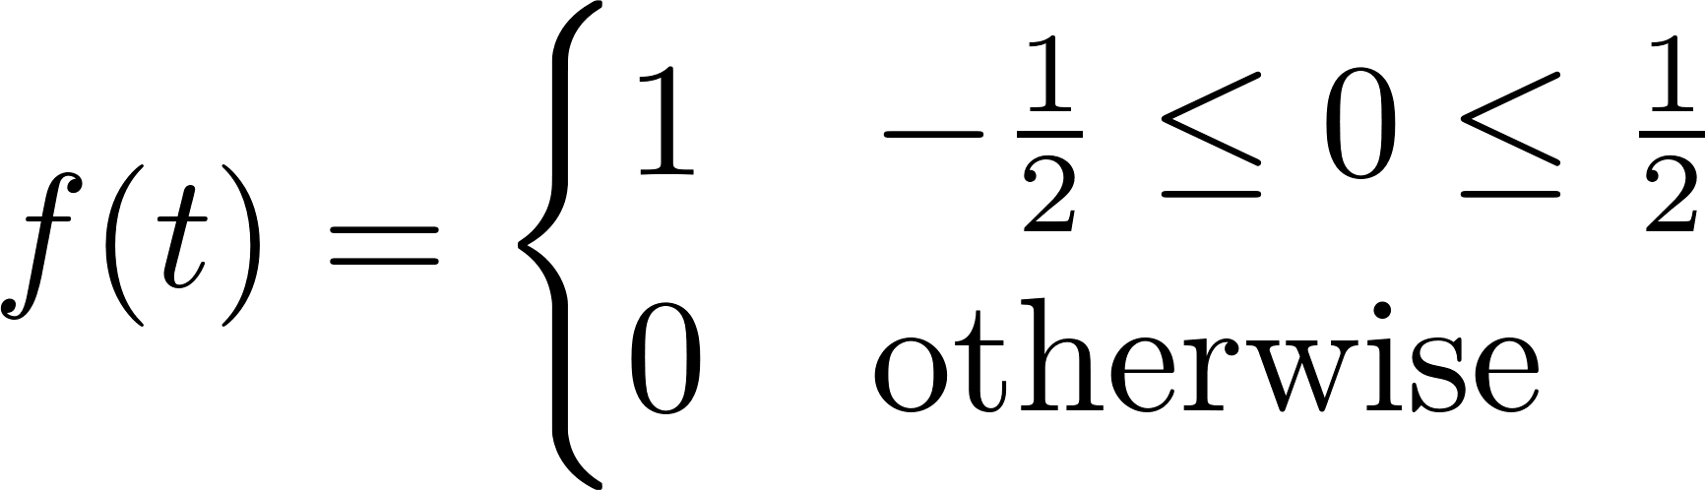
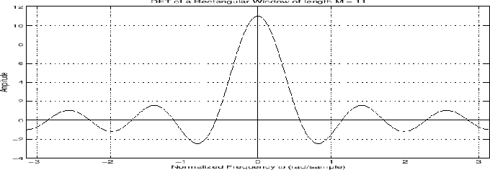
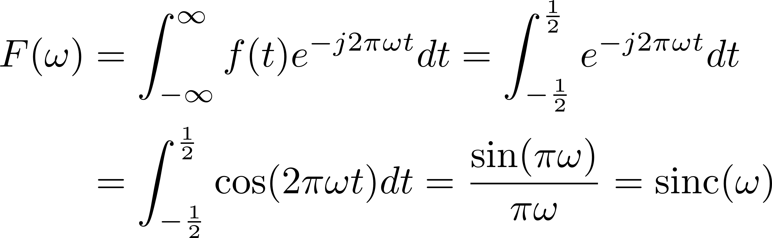
Examples
Square function

Slide 10
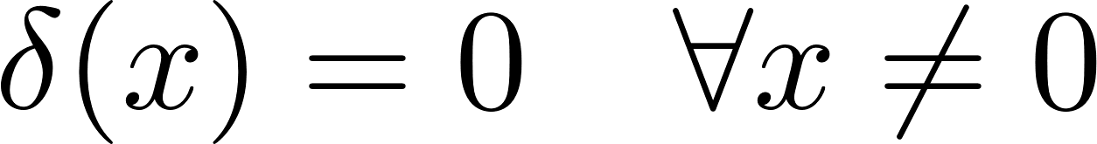
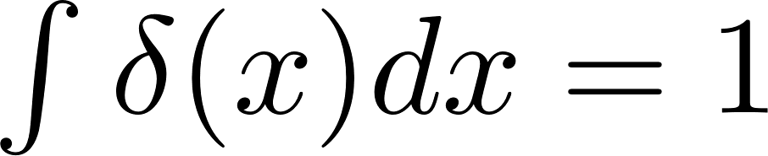
Fourier Transform and Periodic Signals
While the Fourier Transform is useful for representing/analyzing non-periodic signals, we can generalize it to periodic signals.
This can be achieved using distributions (i.e., the delta distribution or unit impulse):
with

Slide 11
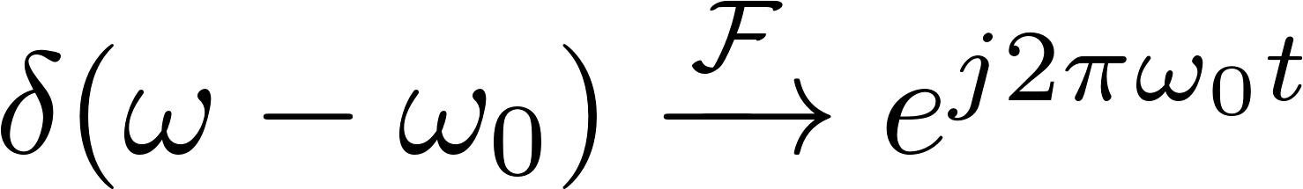
Fourier Transform and Periodic Signals
If we have a unit impulse in the frequency domain:
That is, a unit impulse in the frequency domain corresponds to a conventional (complex) sinusoidal function:

Slide 12
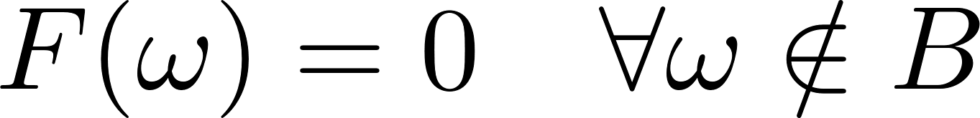
General Properties
Spectrum
Given a signal f, we define its spectrum S_{f} as:
Bandwidth
Given a signal f we can define the bandwith, B, as:

Slide 13
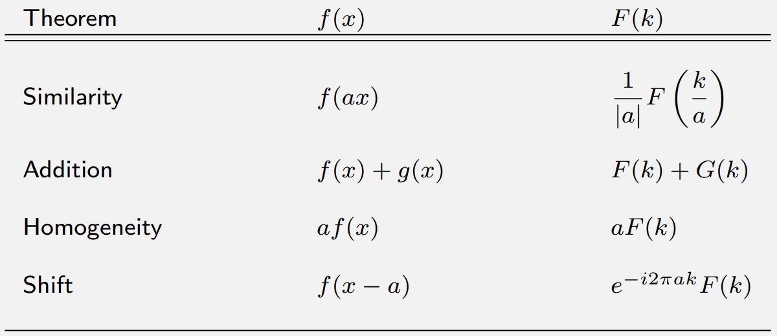
General Properties

Slide 14
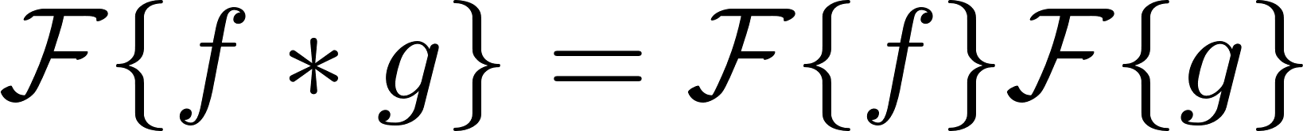
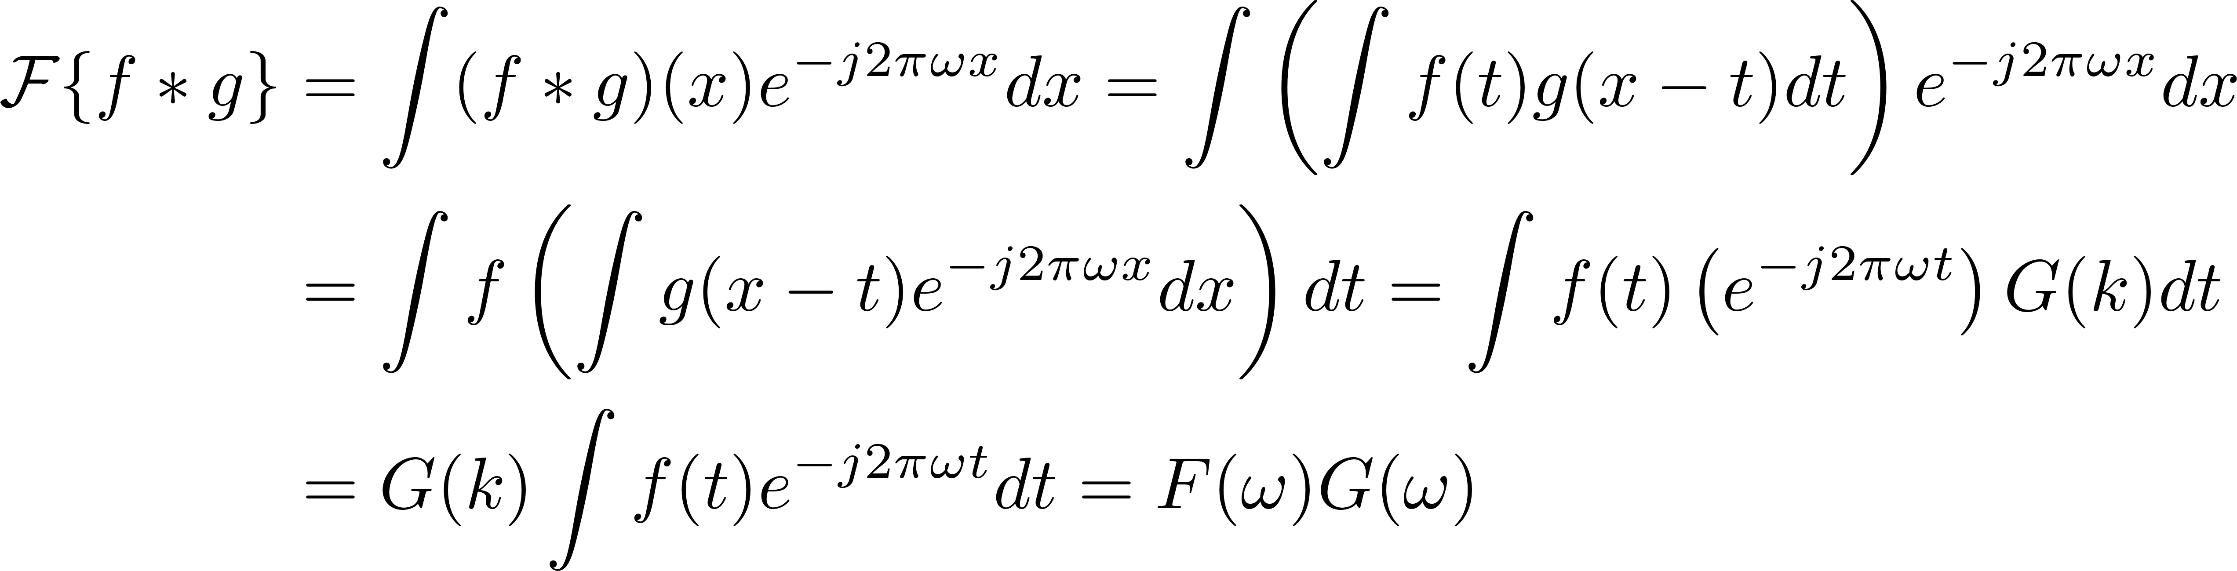
Convolutional Theorem
The Fourier Transform converts convolutions into multiplications:
Proof:

Slide 15
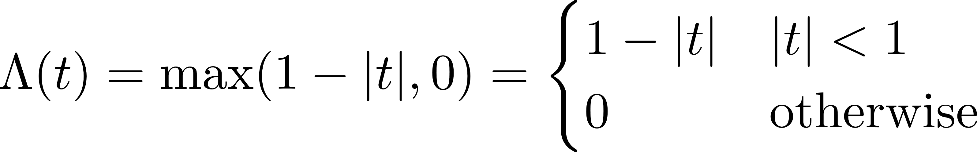
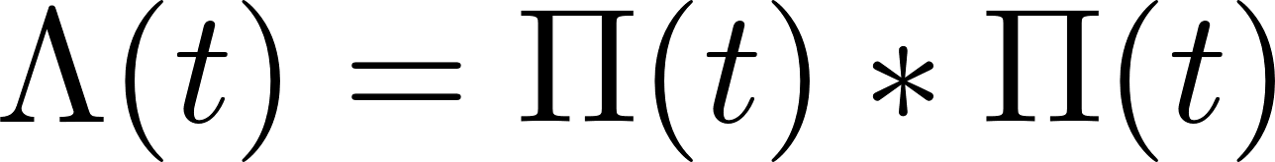
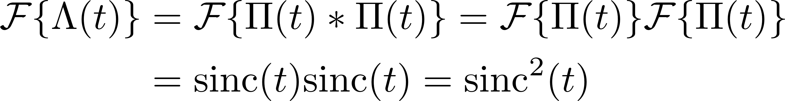
Example: Triangular window
Triangular window:
Alternatively:
That is, with the convolution theorem, we get
Rectangular window

Slide 16
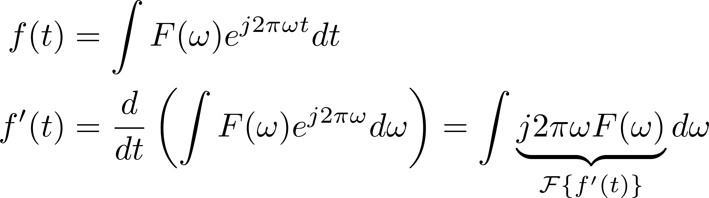
Differentiation
If a function f(t) is differentiable, and both f and f’ are integrable:
Proof:

Slide 17
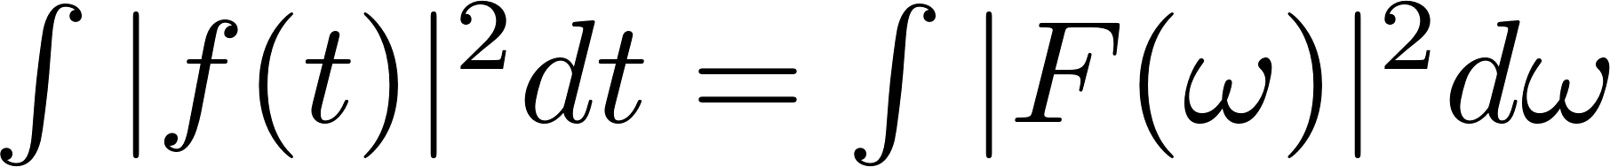
Energy and Power Theorems
Rayleigh’s Theorem (Energy)
Parseval’s Theorem (Power)

Slide 18
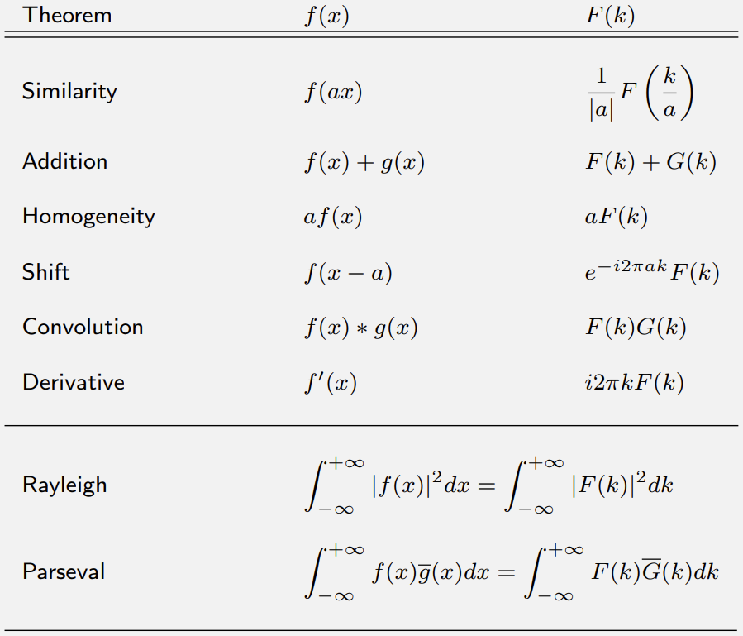
Summary

Slide 19
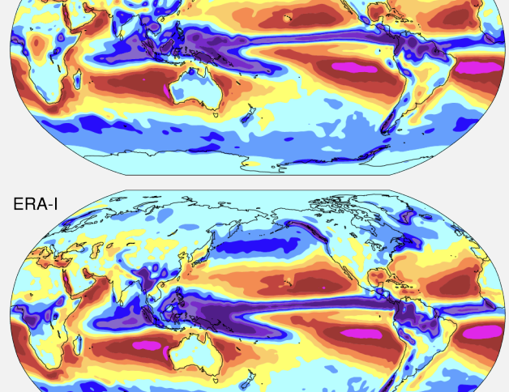
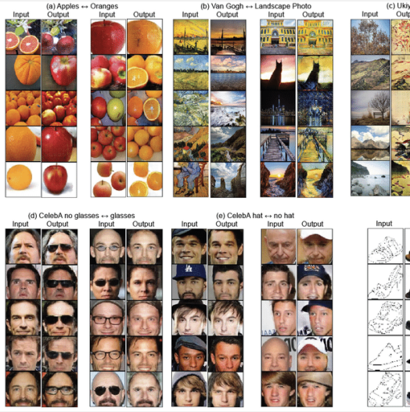
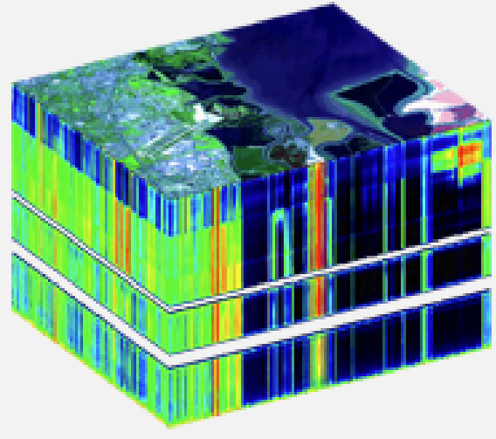
Multiple Dimensions
Until now we focused on one-dimensional signals.
In nature, we can find a wide range of signals, depending on two or more variables, i.e., lieing in a multidimensional space.

Slide 20
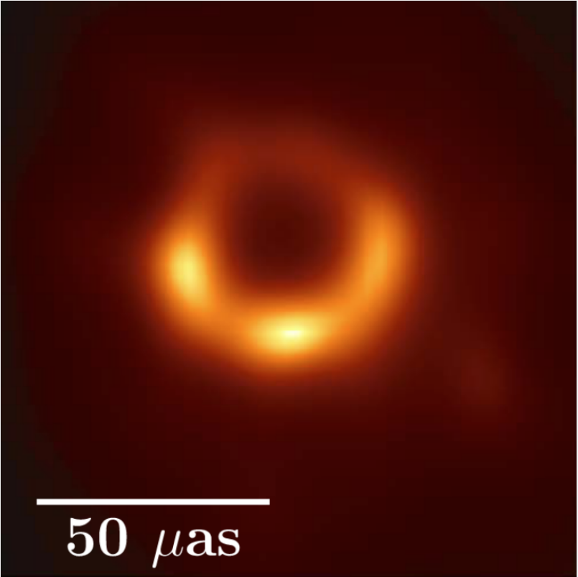
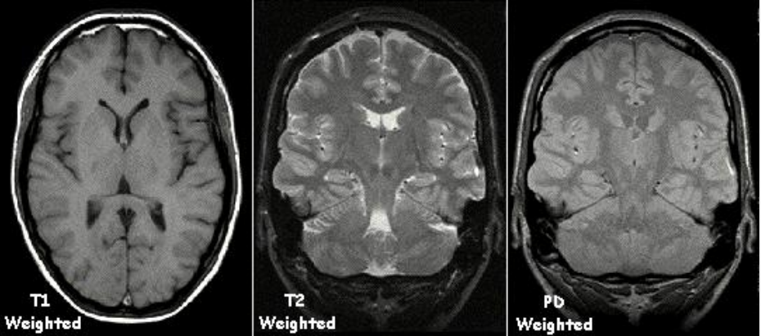
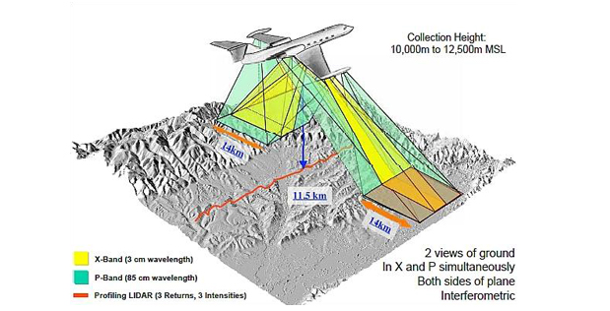
Multidimensional Fourier Domain
The multidimensional Fourier frequency domain can by used for analysis and imaging.
Examples
Astronomy
Medical imaging
Synthetic Aperture Radar

Slide 21
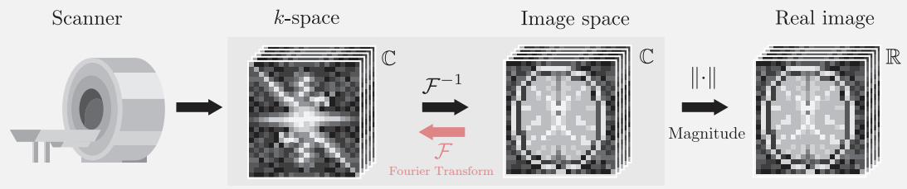
Multidimensional Fourier Domain
In contrast to conventional imaging (intensity measured pixel-by-pixel), MRI scanners measures variation in response to different frequencies.
The result is a complex image in a two-dimensional space of spatial frequencies (k-space).

Slide 22
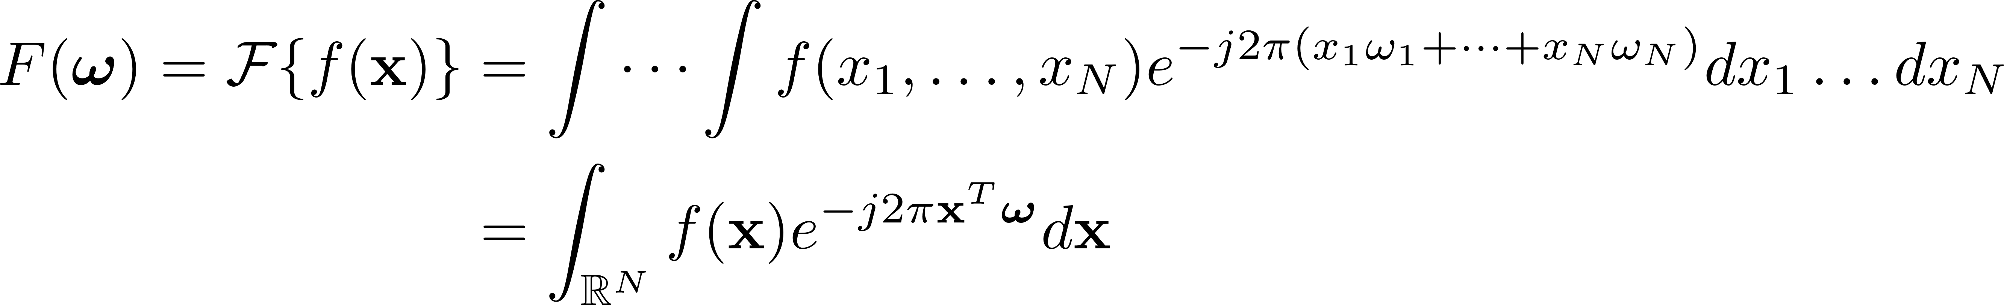
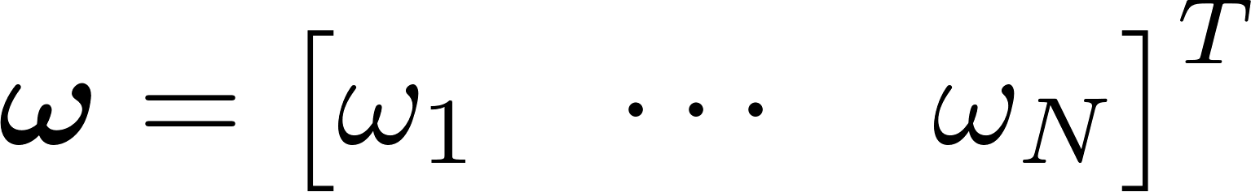
Multidimensional Fourier Transform
Consider a signal f(x) with x = [x₁, x₂, … , x_{N}]^{T} , (x_{n} is real). Then,
Fourier Transform (analysis)
Inverse Fourier Transform (synthesis)
where
(Multidimensional frequency vector)

Slide 23
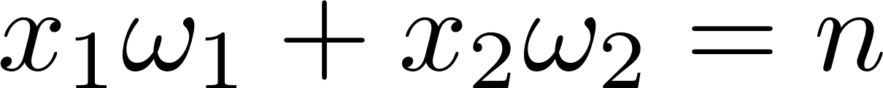
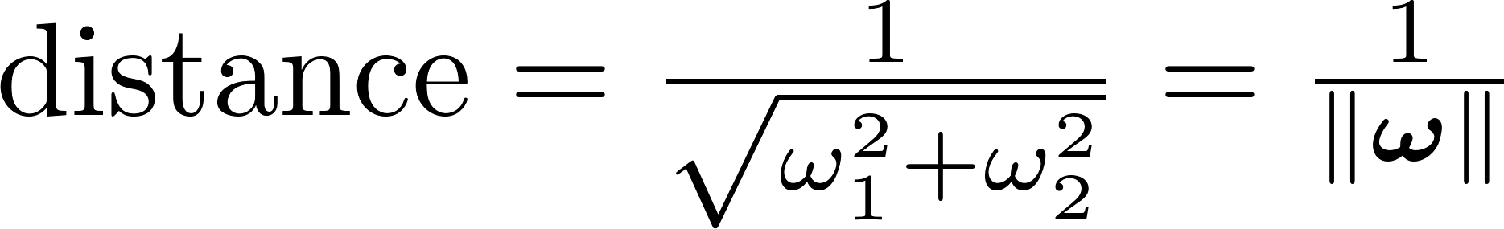
Vector of Frequencies
Let examine a two-dimensional case:
Regardless of the sign, the exponential function equals 1 if the vector product is an integer, n
For a fixed frequency vector, the equation corresponds to a family of parallel lines in the (x₁, x₂) plane, normal to the frequency vector
Distance between two consecutive lines:

Slide 24
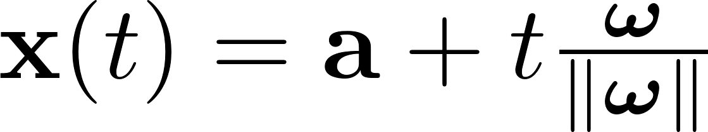
Harmonics and Periodicity
We may now parametrize x using the normalized frequency vector (a = [a₁, a₂]^{T}) is a starting point)
The complex exponential function then becomes
The first term is constant, not depending on t.
The second term is periodic with period 1/||ω||.
Allows us to keep most of the terminology from the 1-D case.

Slide 25
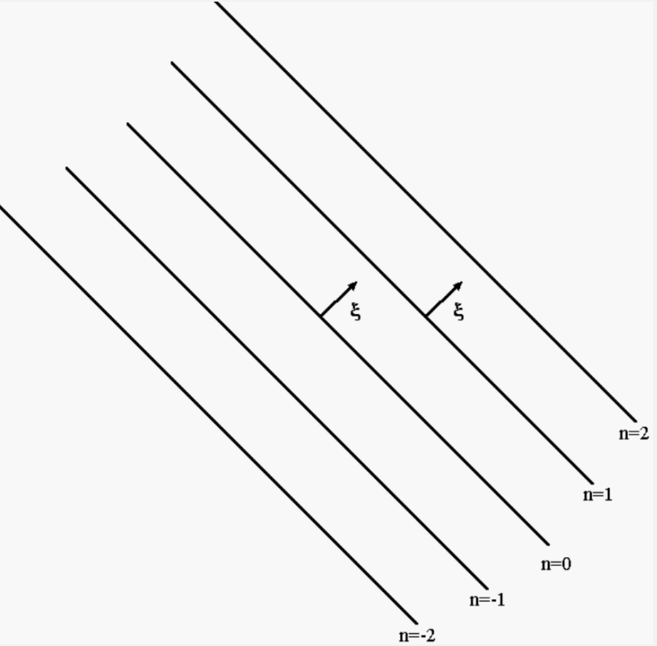

Harmonics and Periodicity

Slide 26
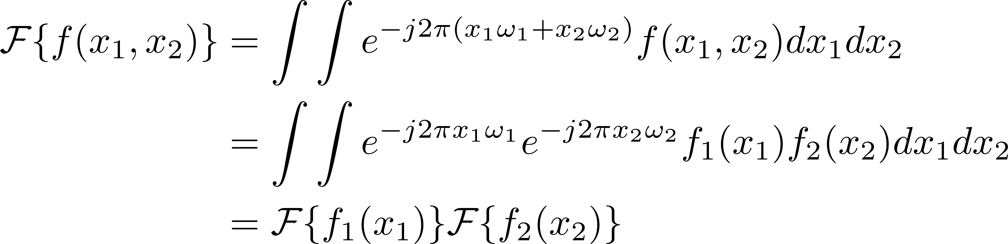
Separable Functions
In some cases, a function f(x) of N variables may be written as N functions of one variable:
This significantly simplifies the Fourier analysis, since (in 2-D)
In general

Slide 27
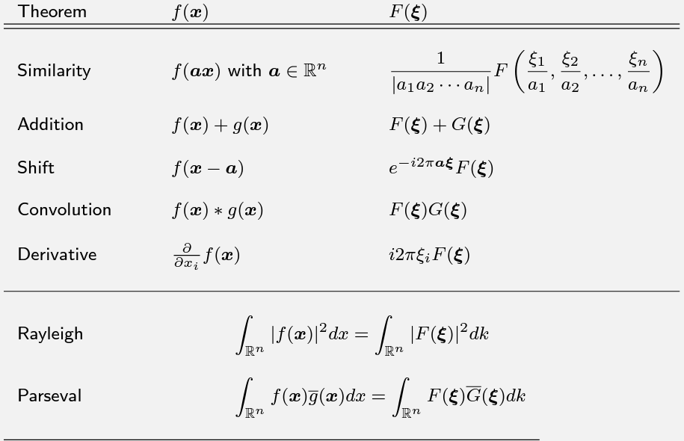
General Properties

Slide 28
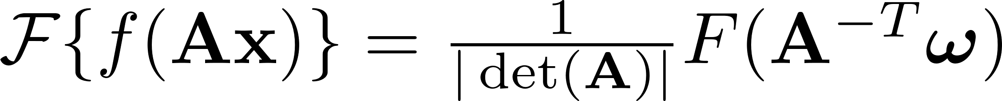
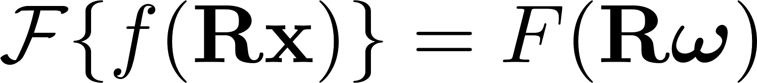
General Stretch Theorem
For any linear transformation, A, of the input data, its corresponding Fourier transform is given by:
Rotations is a particular kind of linear transformation.
The rotation matrix, R, has the special property that R = R^{-T} and det(R) = 1, i.e.,

Slide 29
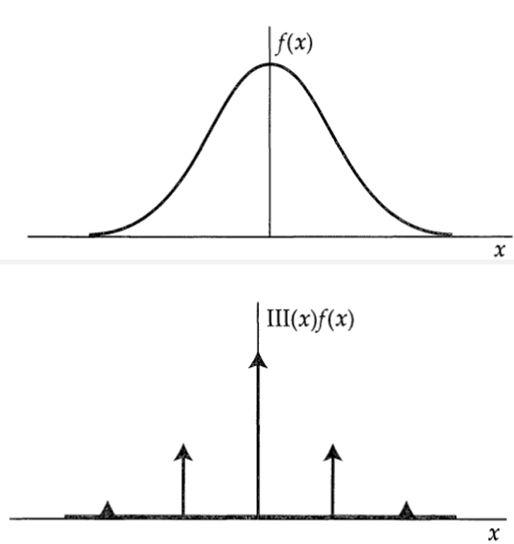
Sampling
We can define the sampling function as
Using this function, we can sampling any other function as

Slide 30
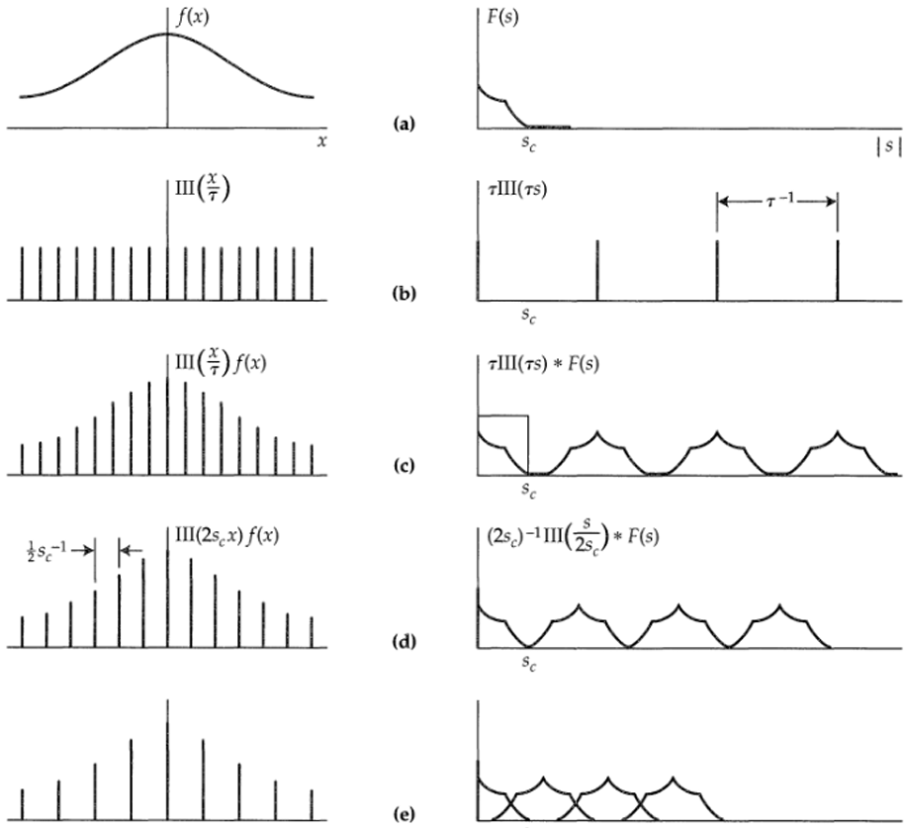
Sampling Rate

Slide 31
Nyquist Sampling
Suppose we are given samples of a function → Can we reconstruct the function perfectly?
Nyquist Sampling Theorem
Let f be a signal with band-limit B.
Then, we can reconstruct f exactly as long as the sampling frequency is greater than 2B.

Slide 32
Multidimensional Discrete Fourier Transform
The MD DFT is a sampled version of the discrete-domain FT.
Obtained by evaluating it at uniformly spaced sample frequencies:
The inverse MD DFT:

